Slide 1
Office 365 development

Slide 2
Deep Dive into Security and OAuth

Slide 3
Agenda
Azure Active Directory
OAuth Primer
Development Scenarios
OAuth Flows
Notes:
What new APIs are available, in preview, in the Office 365 Platform
How to use these API’s in your platform of choice
Some sample business scenarios for leveraging these API’s
Level: Intermediate
Audience: Developer Essentials

Slide 4
Developer vision
USERS
DATA
HTML

Slide 5
Azure Active Directory

Slide 6
Azure Active Directory
Azure Active Directory
Identity and Access Management for the cloud
Can create new directories or manage existing ones in Azure subscription
Used by Office 365 for authentication
Used by Azure for user authentication and application authorization
Notes:
Azure Active Directory is a comprehensive identity and access management cloud solution. It combines core directory services, advanced identity governance, security, and application access management. Azure AD also offers developers an identity management platform to deliver access control to their applications, based on centralized policy and rules.

Slide 7

Work or School Accounts
Azure Active Directory
USER MANAGEMENT
Term for User Accounts in AAD
Required to Access Microsoft Cloud Services
Tenant-Based
DIRECTORY INTERGRATION
FABRIKAM CORPORATION
AZURE ACTIVE DIRECTORY
AZURE ACTIVE DIRECTORY
CONTOSO CORPORATION
AZURE ACTIVE DIRECTORY
LITWARE CORPORATION
APPLICATION INTEGRATION
Notes:
An organizational account is an extension of your computer network that someone from your organization, typically an administrator from your IT department, sets up with Microsoft to provide their users with access to paid Web services or applications hosted in the cloud. For the administrator to provide access to users, they must first create individual user accounts in Windows Azure Active Directory (Windows Azure AD), specify which licensed services the account can access, and then assign each person their individual user ID and password so they can sign in to those services for which they have been assigned licenses to. User accounts stored in Windows Azure AD are referred to as organizational accounts.

Slide 8
Link Office 365 and Azure
Azure Active Directory
Log into Microsoft Azure subscription as administrator
Click on the Active Directory link
Click New>Active Directory>Directory>Custom Create
Select to Add an Existing Directory
Follow the steps to add an existing directory
Notes:
It’s not required to link the Office 365 Directory to an Azure subscription
for simply creating provider-hosted apps, but it makes life a bit easier
and opens up the ability to call into Office 365 from other applications.

Slide 9
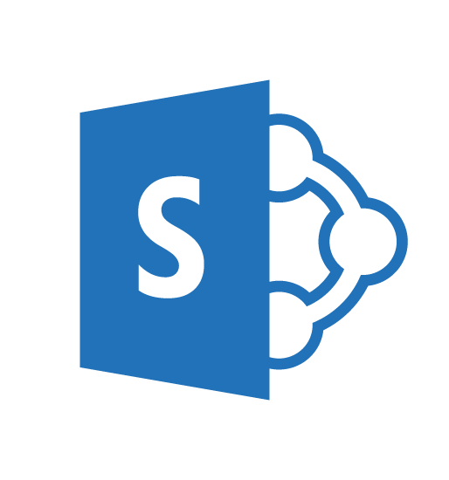

User authentication
Azure Active Directory
Redirected to
login.microsoftonline.com
Subsequent requests
Utilize FedAuth cookie
User attempts to access
SharePoint online resource
Return FedAuth cookie
Present token
Login with
Work or School Account
Issue SAML token

Slide 10
OAuth Primer

Slide 11
What is OAuth 2.0?
OAuth Primer
Simple mechanism to grant a third party access to a user’s resources without sharing the user’s password
Cross platform app authorization
Internet Standard supported by Azure, Facebook, Google, Twitter, and more
Notes:
OAuth provides a simple mechanism for end-users to grant a third party access to their data and resources without sharing their passwords.
It also enables the user to grant access limited by scope and duration.

Slide 12
OAuth 2.0 Actors
OAuth Primer
Client: application requesting access to a user’s resources
Resource Owner: the user who can grant rights to the application
Resource Server: the server hosting the protected resources and exposing a web-based API
Authorization Server—server issuing tokens
Notes:
Client
An application making requests to access protected resources on behalf of the resource owner and with its authorization. This role is defined independently from how it is implemented. It has the same meaning whether is is implemented as an application that executes on a server computer, a desktop computer, or a mobile device). In Concur, the client is referred to as a partner application.
Resource owner
An entity capable of granting access to a protected resource. This is generally an end user.
Resource server
A server hosting the protected resources of the resource owner, capable of accepting and responding to API requests using access tokens.
Authorization server
A server issuing access tokens to the client after successfully authenticating the resource owner and obtaining authorization.

Slide 13
OAuth 2.0 Actors in Office 365
OAuth Primer
Client: SharePoint app, Azure web application, Windows 8 app
Resource Owner: individual or administrator with an Work or School Account in Azure Active Directory
Resource Server: SharePoint, Exchange
Authorization Server: Azure Access Control Services

Slide 14
Application principals
OAuth Primer
Client ID is used to uniquely identify applications
Client Secret is used to authenticate token requests
Notes:
Client ID is a unique identifier
Client Secret is shared between the app and the authorization server
Forms the basis for apps as first-class principals

Slide 15
OAuth 2.0 Tokens
OAuth Primer
Context Token
Information about the Resources Owner and Client that can be used to get an Access Token later.
Refresh Token
A token used to get an Access Token from the Authorization Server.
Access Token
A token passed to the Resource Server authorizing the Client to access resources.
Authorization Code
A code that can be used to register an app on-the-fly.
Notes:
In the OAuth 2.0 model, access to protected resources is done using access tokens —an object with a specific scope, lifetime, and other access attributes. OAuth access tokens are sometimes compared to valet keys. In the same way as a valet key gives restricted access to a car, allowing a valet to drive it but not open the trunk or the glove compartment, the access token allows a client application restricted access to a user’s data at a resource server via tokens issued by an authorization server in response to the user authorizing access.
With OAuth 2.0, a third-party application does not use the resource owner's credentials to access protected resources. Instead, the third-party application obtains an access token. Access tokens are issued to third-party clients by an authorization server with the approval of the resource owner. The client uses the access token to access the protected resources hosted by the resource server.

Slide 16
Bearer Tokens
OAuth Primer
OAuth 2.0 Access Tokens are unbound tokens (a.k.a, “Bearer Tokens”)
An Access Token can be used by any application that possesses it
Always use SSL—OAuth design depends on it!
Never expose tokens in JavaScript or allow them to be accessed by client-side debugging tools
If an Access Token is compromised, damage is limited by expiration
If a Refresh Token is compromised, damage is limited because the Client ID and Client Secret are required to get an Access Token from a Refresh Token.

Slide 17
Development Scenarios

Slide 18
Development Scenarios
Provider-Hosted Apps

Slide 19
App principals
Development Scenarios
Apps must be registered with SharePoint online
Client ID—generated during the registration process
Client Secret—generated during the registration process
App Host Domain—the domain of the Azure web site hosting the app
Redirect URL—the URL of the return page after permissions are granted
SharePoint provides registration management pages
AppRegNew.aspx—for registering a new app
AppInv.aspx—for updating registered apps
AppPrincipals.aspx—lists all registered apps
Notes:
Apps are first-class principals in SharePoint
They have an identifier and permissions, which are tracked in SharePoint through the registration and installation process

Slide 20
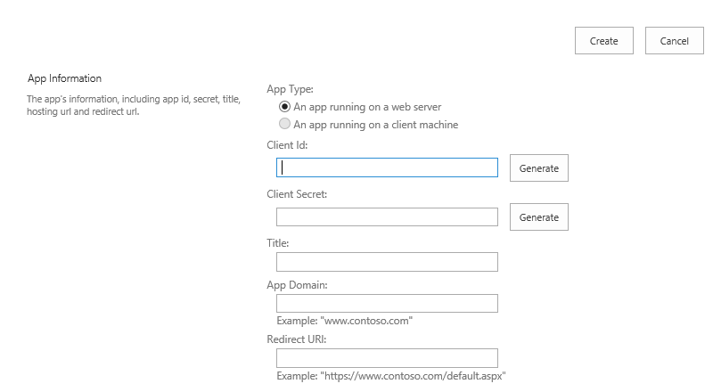
Registering a new app
Development Scenarios
Generated value
Generated value
Free text value
Azure domain (e.g., myapp.azurewebsites.net)
Web address (e.g., https://myapp.azurewebsites.net)
Notes:
Apps must be registered with SharePoint. This page will generate a new client ID and secret for the app. If deployed to Azure, use that information to fill out the rest of the form.

Slide 21
Provider-hosted app flow scenario
Development Scenarios
User has Work or School Account
App registered with SharePoint Online
App deployed to SharePoint Online
Remote Web deployed as an Azure Website
Client ID and Client Secret defined in AAD

Slide 22
OAuth 2.0 Flow Provider-Hosted app
Development Scenarios
App requests Access Token
using refresh Token
Access Token returned
Azure Web Site
(Client)
Context Token returned
and user redirected to app
App extracts Refresh Token
from Context Token
Access Token presented
Along with request
Response returned
Request Context token
for user
User launches app
Context Token returned
End User
(Resource Owner)
Azure ACS
(Authorization Server)
SharePoint Online
(Resource Server)

Slide 23
SharePointAcsContext Class
Development Scenarios
Inherits SharePointContext
Provides specific properties and methods for dealing with context and access tokens
CSOM
CreateAppOnlyClientContextForSPAppWeb
CreateAppOnlyClientContextForSPHost
CreateUserClientContextForSPAppWeb
CreateUserClientContextForSPHost
REST
AppOnlyAccessTokenForSPAppWeb
AppOnlyAccessTokenForSPHost
UserAccessTokenForSPAppWeb
UserAccessTokenForSPHost
Notes:
Abstracts the management of tokens to make it easier

Slide 24
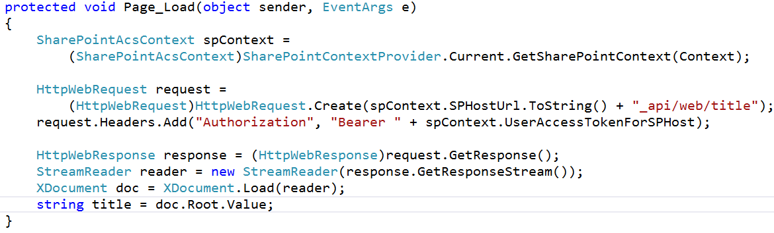
Making REST Calls with OAuth
Development Scenarios

Slide 25
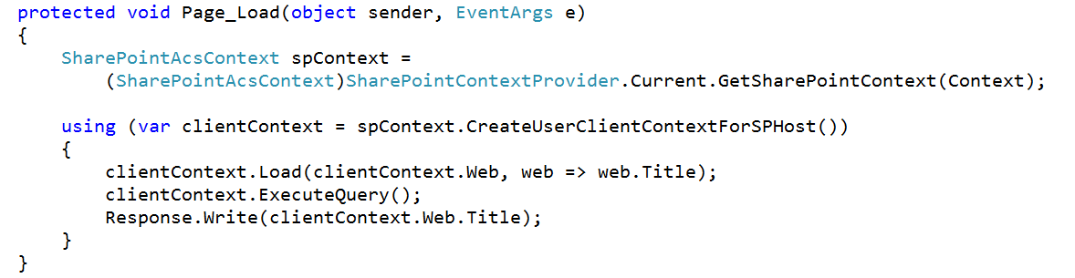
Making CSOM Calls with OAuth
Development Scenarios

Slide 26
Demo
Provider-Hosted App

Slide 27
Development Scenarios
Office 365 APIs

Slide 28
Office 365 APIS Flow scenario
Development Scenarios
User has Work or School Account
Application deployed as an Azure Web Site
Application does not require explicit permission grant

Slide 29
OAuth 2.0 Flow Office 365 APIs
Development Scenarios
Auth Code,
App Id, App Secret sent
User accesses web application
Access and Refresh
Tokens returned
Azure Web Site
(Client)
Access Token presented
Along with request
Response returned
Consent dialog displayed
Grant access using Consent Dialog
Auth Code returned and user redirected
Redirected to AAD
End User
(Resource Owner)
Azure ACS
(Authorization Server)
SharePoint Online
(Resource Server)

Slide 30
Office 365 discovery services
Development Scenarios
Automatically determine URL of Office 365 services
Supports device app and website flows
Secured using Azure AD authentication
Serves information stored about services in AAD
Notes:
The heart of the Office 365 APIs is the discovery service
Discovery services allow you to locate the e resource you want to utilize

Slide 31
Office 365 clients
Development Scenarios
AadGraphClient—Azure Active Directory
ExchangeClient—Calendar, Contacts, Mail
SharePointClient—Files

Slide 32
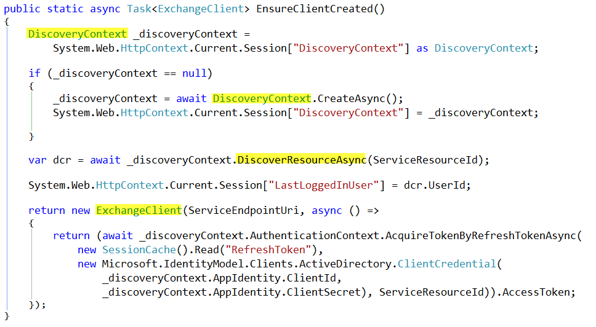
Development Scenarios

Slide 33
Development Scenarios
OAuth Controller

Slide 34
OAuth Controller class
Development Scenarios
Embodies all OAuth operations
Allows code customizations for special situations
Available on GitHub
https://github.com/AzureADSamples/WebApp-WebAPI-OAuth2-UserIdentity-DotNet/ blob/master/WebApp/Controllers/OAuthController.cs
Notes:
The Oauth controller should be used in scenarios where you need to customize how tokens are handled. For example, you might want to save them to a database and make them available across sessions.

Slide 35
OAuth Controller Flow scenario
Development Scenarios
User has Work or School Account
App deployed as an Azure Web Site
App registered with Azure Active Directory
Client ID and Client Secret defined in AAD
Permissions granted specifically in AAD

Slide 36
OAuth 2.0 Flow OAuth Controller
Development Scenarios
The consent form is not utilized when permissions are explicitly granted in AAD.
Access and Refresh
Tokens returned
User accesses web application
Auth Code, App Id, App Secret sent
Azure Web Site
(Client)
Access Token presented
Along with request
Response returned
Auth Code returned and user redirected
Redirected to AAD
End User
(Resource Owner)
Azure ACS
(Authorization Server)
SharePoint Online
(Resource Server)

Slide 37
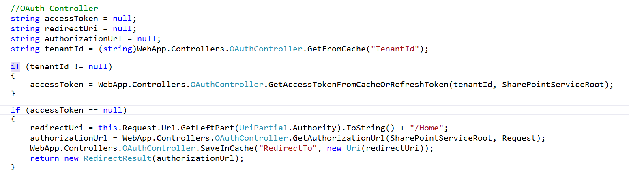
Programming the OAuth Controller
Development Scenarios
Notes:
The Oauth controller needs you to provide a redirect URL and it will give back the authorization URL

Slide 38
Demo
Oauth Controller

Slide 39
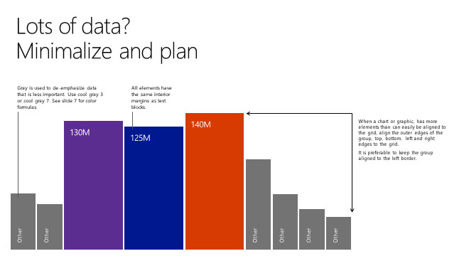
Authorization Code Flow Client Credentials Flow

Slide 40
Obtain Access Tokens with OAuth Flows
OAuth Flows
Obtain access tokens using different defined “OAuth Flows”
Multiple flows defined in OAuth 2.0 spec
Both the Issuer and Resource must support the flow to use it
Flow Options with Office 365 and Azure AD
Authorization Code Flow
Client Credentials Flow (App only)
Implicit Flow

Slide 41
Authorization Code Flow
OAuth Flows
Most common
Very secure—application never gets user’s creds
Flow described:
Web app redirects user to Azure AD to login
Upon successful login, Azure AD redirects user back to web app with an authorization code
Web app uses this code to request access token on behalf of user
Scenarios:
Web applications that use federated logins
User interaction present

Slide 42
Client Credentials Flow (aka: app only)
OAuth Flows
Very powerful
Requires global tenant admin consent
Not user consent
Flow described:
App configured with the public part of a certificate
App submits an encrypted request to the issuer requesting access token
Issuer returns access token back to requestor
Scenarios:
App only rights
Zero user interaction
Service/daemon processes

Slide 43
Demo
Client Credentials Flow

Slide 44
Summary
Azure Active Directory
OAuth Primer
Development Scenarios
OAuth Flows
Notes:
What new APIs are available, in preview, in the Office 365 Platform
How to use these API’s in your platform of choice
Some sample business scenarios for leveraging these API’s
Level: Intermediate
Audience: Developer Essentials

Slide 45
Developer Program launch
1 YEAR FREE
E-mail Newsletters
Free Developer Subscription
Free Training
Free Tools
Webinars
http://dev.office.com/devprogram

Slide 46


Engage
Office 365 Network
https://www.yammer.com/itpronetwork
Twitter
S
S
t
t
a
a
r
r
t
t
@OfficeDev
Stack overflow
[ms-office]
Channel 9 Dev Show
http://aka.ms/O365DevShow
Podcasts http://dev.office.com/podcasts
Snack Demos
http://aka.ms/o365DevSnackDemos
UserVoice
http://officespdev.uservoice.com/

